Slide 1
Topic Modeling of Life Tip Posts on Reddit
DTSA-5510 Unsupervised Algorithms in Machine Learning
Andrea Cruz

Slide 2
Outline
Executive Summary
Introduction
Methodology
Results
Conclusion
Appendix

Slide 3
Executive Summary
This project aims to implement Unsupervised Machine Learning models to help identify distinctive topics for Life Tips Posts on Redit. The following methodology was used:
Collect Life Tips Posts under subreddit categorization of “Life Pro Tips” and “You Should Know” that detail advice other users have for various avenues of life
Process and clean dataset as necessary
Perform exploratory data analysis by looking at descriptive statistics and data visualizations
Implement and evaluate unsupervised machine learning models to perform classification.
In conclusion, the best interpretive model was selected as the categorization method for Life Tip Posts.

Slide 4

Introduction
Reddit is a great resource that houses a plethora of information contributed to by individuals from all walks of life. Subreddits like r/lifeProTips and r/YouShouldKnow are well-known for having practical tips that anyone can apply to their life. However, due to its open-source nature there is often not proactive measures put in place to help categorize and aid in narrowing down a new user's search. Given the vast number of posts that are made daily, it would be inefficient (if not impossible) as well as untimely for human review of all posts. The purpose of this analysis is to develop an unsupervised machine learning model that can develop and assign appropriate topic categories.

Slide 5
Methodology: Data Collection
Data was taken from Kaggle.com and lists Helpful Life Tips from Reddit Dataset with over 1000 upvotes during 2005-2002
Background information provided by the hosts indicated that the attributes in the dataset that could be most useful were text fields “postTitle” and ”postBody.”
Since around 28% of the dataset did not have any postBody entries, I decided to utilize the postTitle as the targeted field

Slide 6

Methodology: Preprocessing
postTitle was initially cleaned by converting all words to lowercase, removing punctuation, numbers, extra spaces, standard stop words in English. Additionally, words with less than 2 letters were also removed.
Text was also tockenized and lemmantized to ease with exploratory visualizations
The top 100 words were examined and additional stopwords were identified to be removed

Slide 7

Methodology: EDA
Distribution of scores were outputted to identify any outliers
Distribution of postTitle lengths were outputted to identify any outliers
The overall top 10 terms were ranked based on average TF-IDF (term frequency-inverse document frequency scores)

Slide 8
Methodology: Model implementation
Data was cleaned and additional stop words were removed iteratively as needed
The main algorithms implemented were TF-IDF & Bag of Words vectorizers and Non-negative Matrix factorization and LatentDirichletAllocation. Both models were originally implemented with different hyperparameters using Sklearn.
The LDA model was additionally implemented with the gensim module so that it could be visually evaluated with the pyLDAvis module. This module allows for an intertopic distance map.

Slide 9
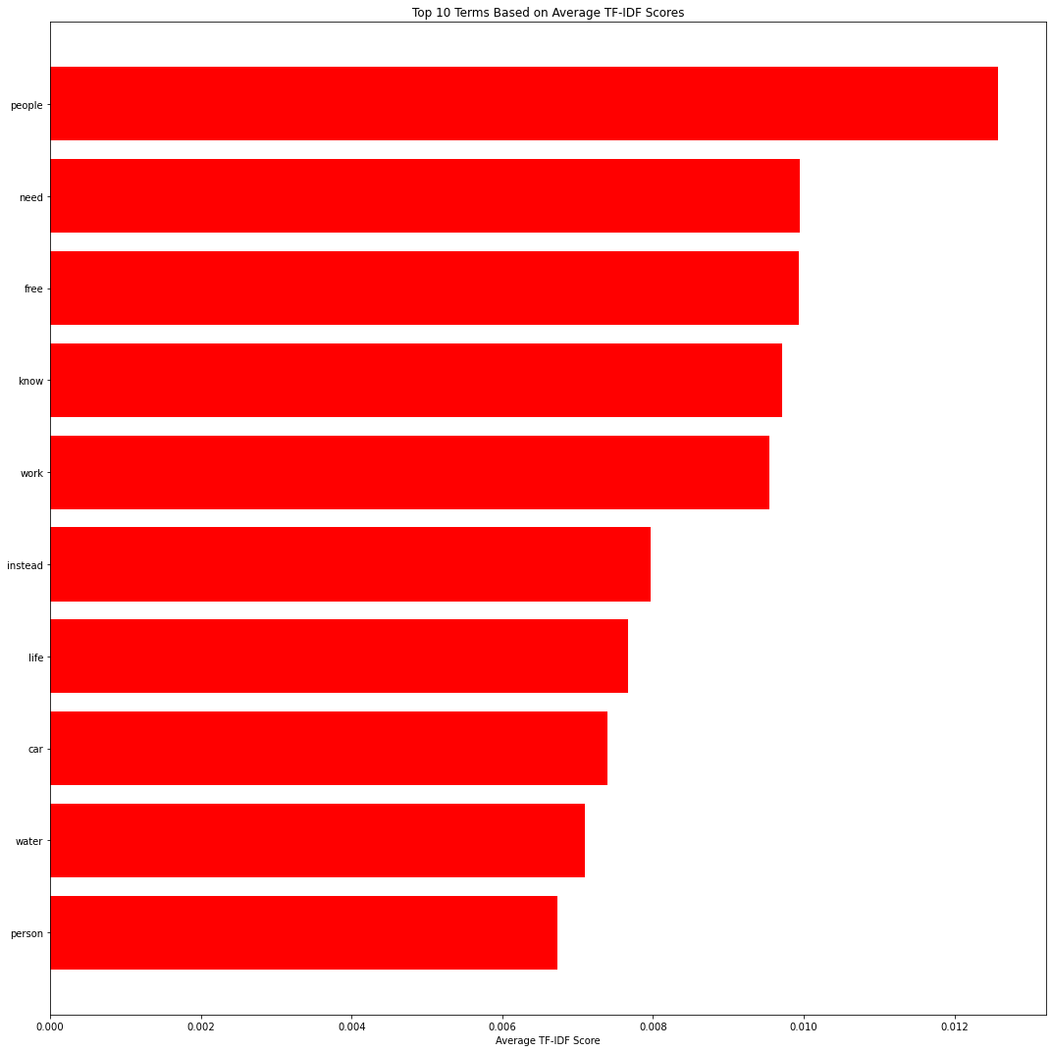
Results: EDA
Outlier tips with >40000 score were removed
After cleaning, Top 100 words were examined and iteratively cleaned to get to a top 10 Terms list of only relevant terms

Slide 10
Results: NMF implementation
Different hyperparameters were tested with the TF-IDF vectorizer and the NMF model to produce topics. The top scored words were evaluated for interpretability, and topic names were assigned
Subsequently, the posts were iteratively assigned a topic using the NMF model. Distribution of posts per topic were observed.
Samples from each topic were evaluated for accuracy of topic naming and assignment.

Slide 11
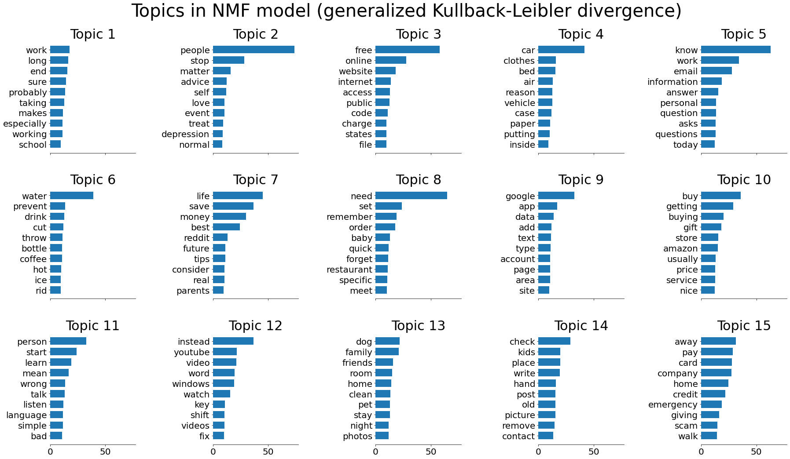

Slide 12
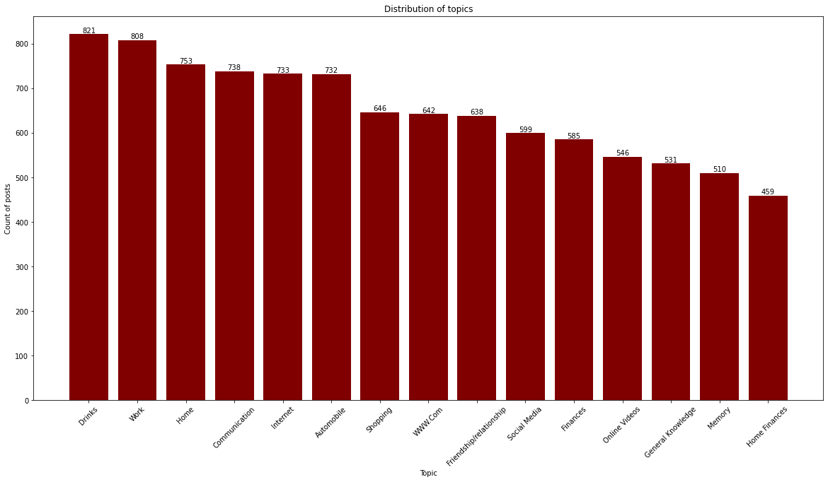

Slide 13
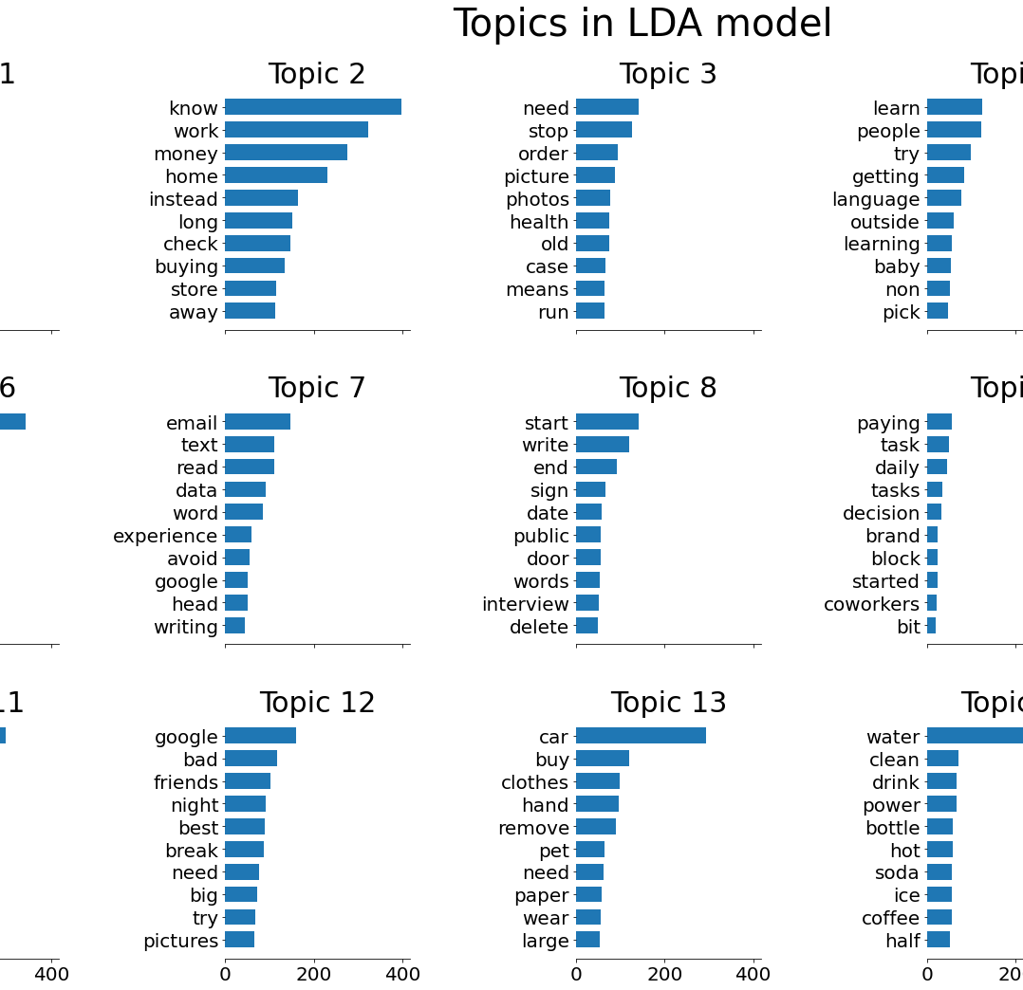
Results: LDA implementation
Initial implementation was performed with scikit learn model. Top words did not make it easy to assign concise topic name

Slide 14
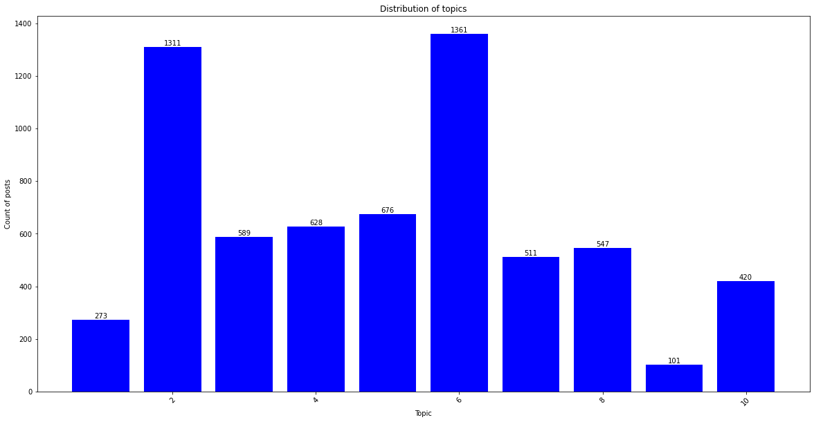

Slide 15

Results: Alternate LDA implementation
Alternate implementation of the LDA algorithm was incorporated using the gensim module
The original # of topics parameter of 15 proved to have a lot of overlapping topics, so it was reduced to 7. This led to larger distanced more distinct topics.
There is still a couple overlaps/closely related topics. Additionally, the top 30 most salient terms list was informative to perform additional optimization by adding more words to the stop words list when performing the cleaning.

Slide 16
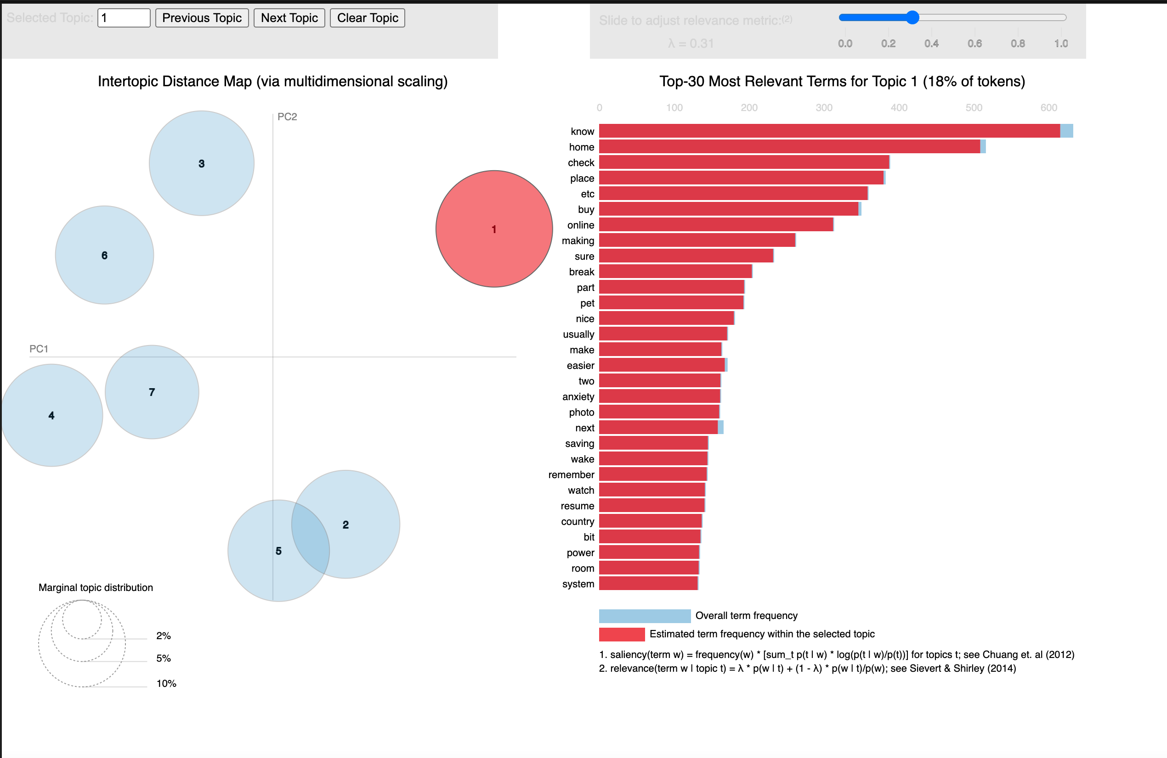

Slide 17
Results: Overall model implementation
The NMF provided more interpretable results, but the LDA model allowed for better visualization of the model overall.
For this project, I decided to stop here having built and trained a couple models and presented the results. There is room for more improvements and further optimizations in either models, although the usage of the pyLDAvis module has proved integral in the interpretation and visualization of the model.

Slide 18

Conclusion
Through implementation and optimization of different machine learning models, it was determined that both models still need additional optimization to get to an accurate predictor. However, in the realm of unsupervised learning it has provided a framework of possible topic ideas that can be further tuned.
For the future expansion of this project, I'd like to continue to optimize the gensim implemented LDA model by removing additional stop words to get the topics more distinct from each other. Further more, I'd like to take some time to evaluate a sample set of posts from each topic to validate the topic assignments.

Slide 19
Appendix
All source code for Jupyter notebook and slides can be found in the following GitHub repository:
https://github.com/ancr8790/LifeTipsRedditClassification

